Slide 1

Using Symmetric and Asymmetric 3D Supernova Models to Constrain the Origins of Presolar SiC Grains
Jack Schulte^{1,2∞}
Maitrayee Bose^{1∞}, Patrick Young¹, and Gregory Vance¹
¹School of Earth and Space Exploration, ²Department of Physics
∞ Center for Isotope Analysis (CIA)
Notes:
I like that you introduce yourself. But you need a better starting like after that. I have edited the slide.

Slide 2
What are presolar grains?
Dust grains in meteorites with large nucleosynthetic anomalies (e.g., Zinner, 2014; Nittler and Ciesla, 2016)
Isotopic compositions can trace their stellar sources and nucleosynthetic histories
We focus on SiC X grains using new 3D supernova models
Solar
Solar
Data retrieved from Presolar Grain Database (Hynes and Gyngard, 2009), Marhas et al., 2008, and Liu et al., 2016.
Notes:
Mention that we will only be discussing X grains and nova grains but that additional work has been done looking at C grains and silicon nitride grains
Comments from mb: Can you change the legend to show the X grains first? This plot has weird things going on. I see a lot of mainstream grains in the SN region in grey. Why? I see a Y grain in the AB grain region. Why? I have moved the plot to the left. Remember that slides can easily get cut off from the sides/top/bottom. I have moved the contents of the slides up. You need to do that for all your slides. Right now you are using the default heading location but that is too low. I tend to put outline of the heading touch the slide boundary.

Slide 3
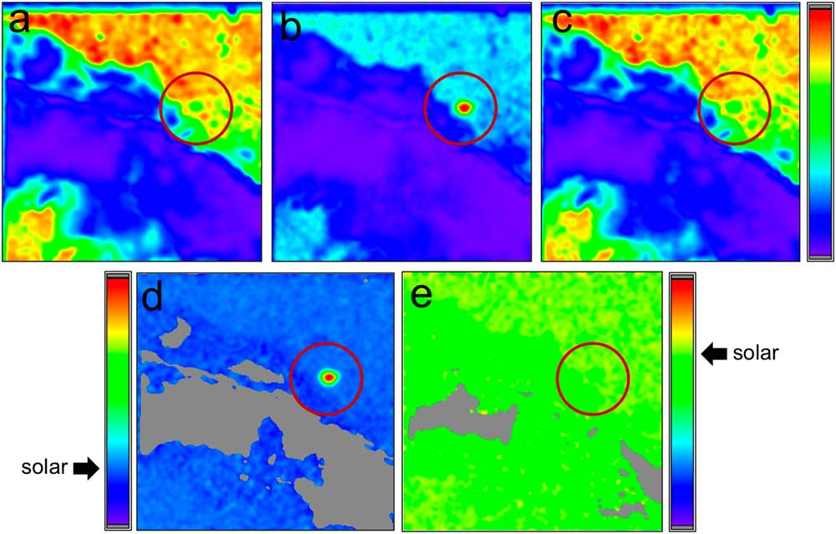
How do we find presolar grains?
Ion beam used to sputter the surface of a cross-section of a primitive meteorite
Areas with anomalous isotopic compositions are identified
These spots are further analyzed to determine type based on certain isotope signatures
False color NanoSIMS raster ion images: (a) ¹⁶O (b) ¹⁷O (c) ¹⁸O
(d) ¹⁷O/¹⁶O (e) ¹⁸O^{/16}O
(Floss, 2018)
Notes:
Mention that we will only be discussing X grains and nova grains but that additional work has been done looking at C grains and silicon nitride grains
Comments from mb: Can you change the legend to show the X grains first? This plot has weird things going on. I see a lot of mainstream grains in the SN region in grey. Why? I see a Y grain in the AB grain region. Why? I have moved the plot to the left. Remember that slides can easily get cut off from the sides/top/bottom. I have moved the contents of the slides up. You need to do that for all your slides. Right now you are using the default heading location but that is too low. I tend to put outline of the heading touch the slide boundary.

Slide 4
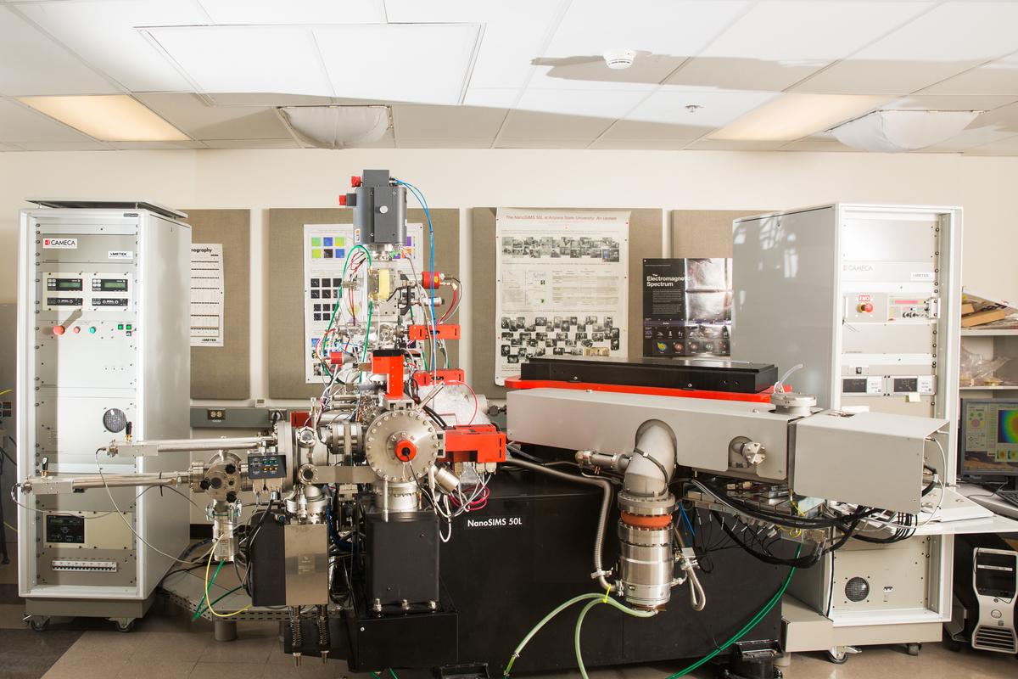
ASU’s NanoSIMS 50L

Slide 5
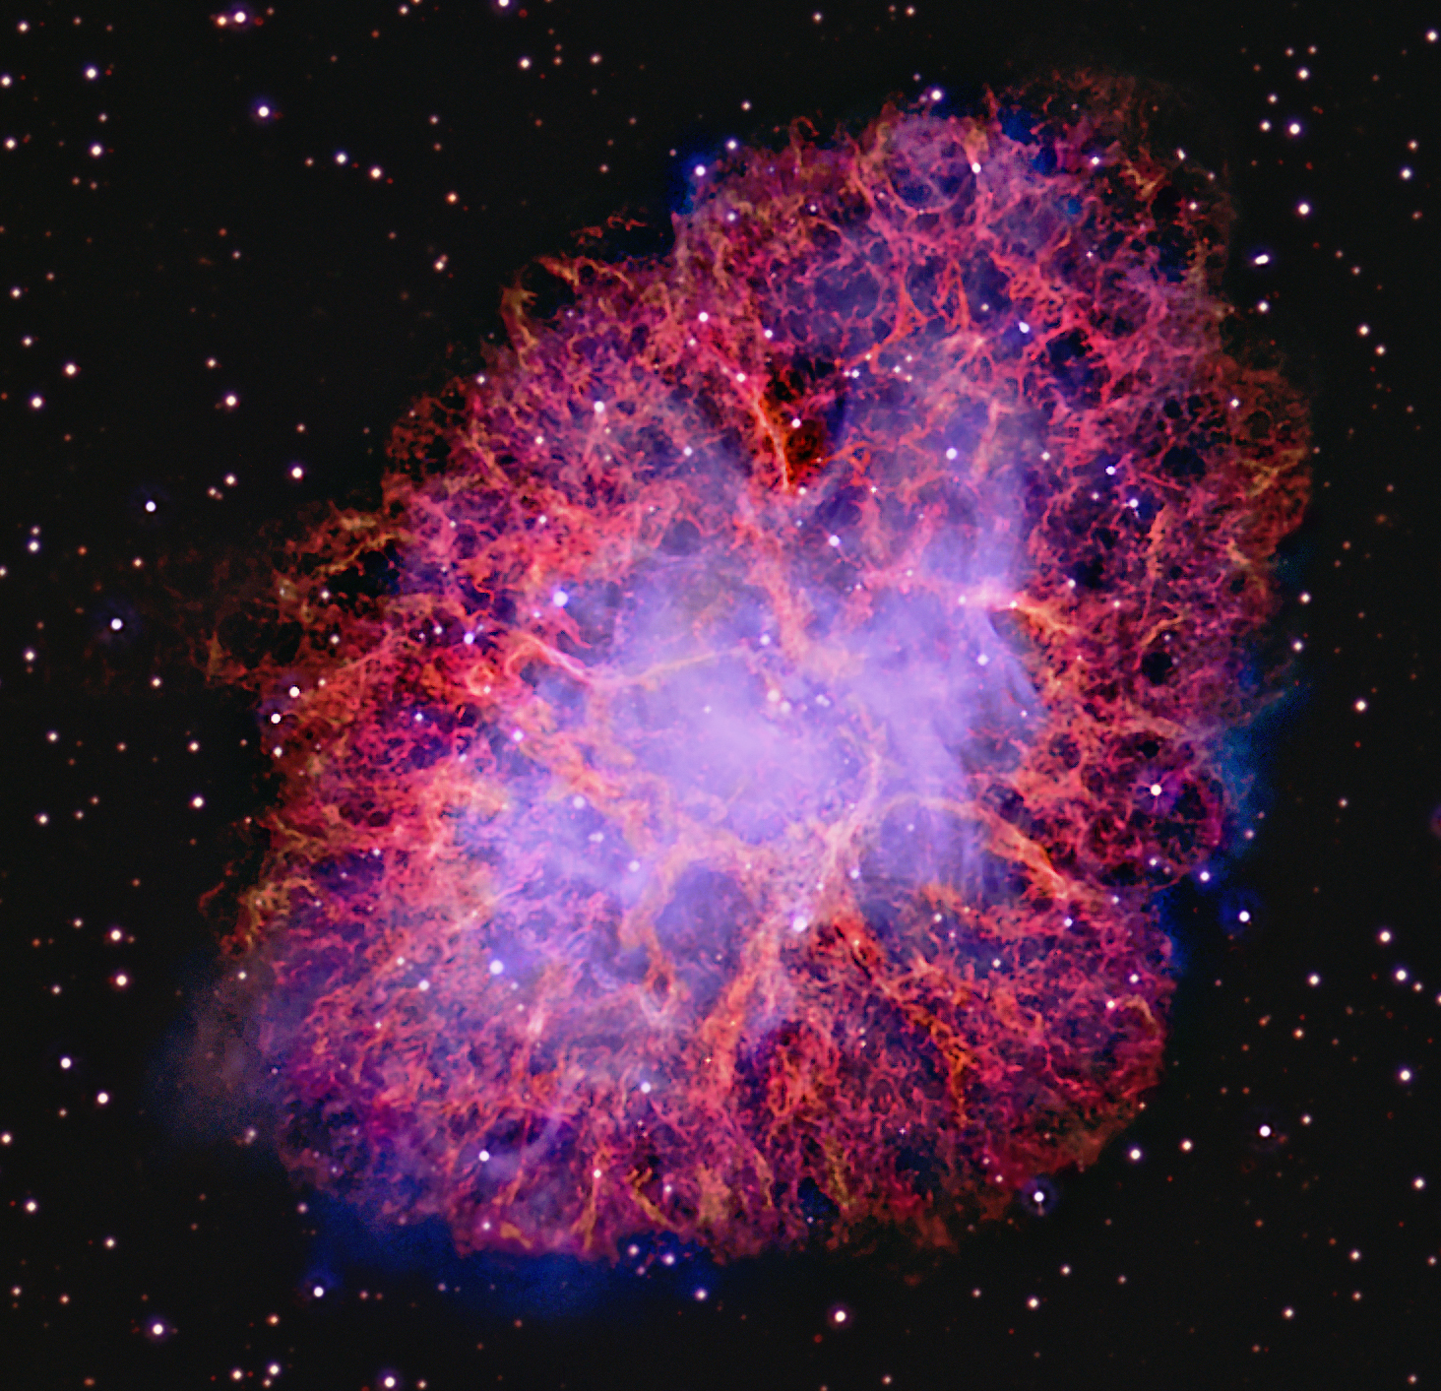
3D supernova models
Crab Nebula
Issues involved
  Computationally intensive
  Time consuming
Most observed supernova remnants are asymmetric
Benefits
  Allows us to account for asymmetry, convection, mass loss, and turbulence (Ellinger et al., 2012)
Image credit: Nilsson & Liverpool Telescope
Notes:
-End this slide with a result: we have found, as we are about to show you, that asymmetry does have an effect on certain isotope abundances in clumps

Slide 6

Models used in this work
Four post-explosion, two pre-explosion models
Smoothed-particle hydrodynamics (Benz, 1988 or Monaghan, 1992)
  “particles” $→$ “clumps”
  Average mass of each clump: 9.6 × 10⁻⁶ M⊙ (3.2 M⊕)
 | g292-j4c | jet3b | 50Am | cco2
Nickname | 20A | 15A | 15S | 15A-CCO
Progenitor Mass | 20 M⊙ | 15 M⊙ | 15 M⊙ | 15 M⊙
Asymmetric? | Yes; 2:1 velocity | Yes; 2:1 velocity | No; spherically symmetric | Yes; Central compact object
Notes:
-Describe each of the models
-Briefly discuss SPH
-Allows for use of ODEs (instead of a grid with spatial derivatives)
-Talk about how this SPH code includes variable smoothing lengths
-Define clumps
-Mention how the data was analyzed (MATLAB, SPLASH)

Slide 7
Post-Explosion Models: Carbon & Nitrogen
Solar
Solar
See Poster #1152 by Bose and Starrfield [this evening]

Slide 8
Post-Explosion Models: Carbon & Nitrogen
Solar
Solar

Slide 9
Post-Explosion Models: Carbon & Nitrogen
Solar
Solar

Slide 10
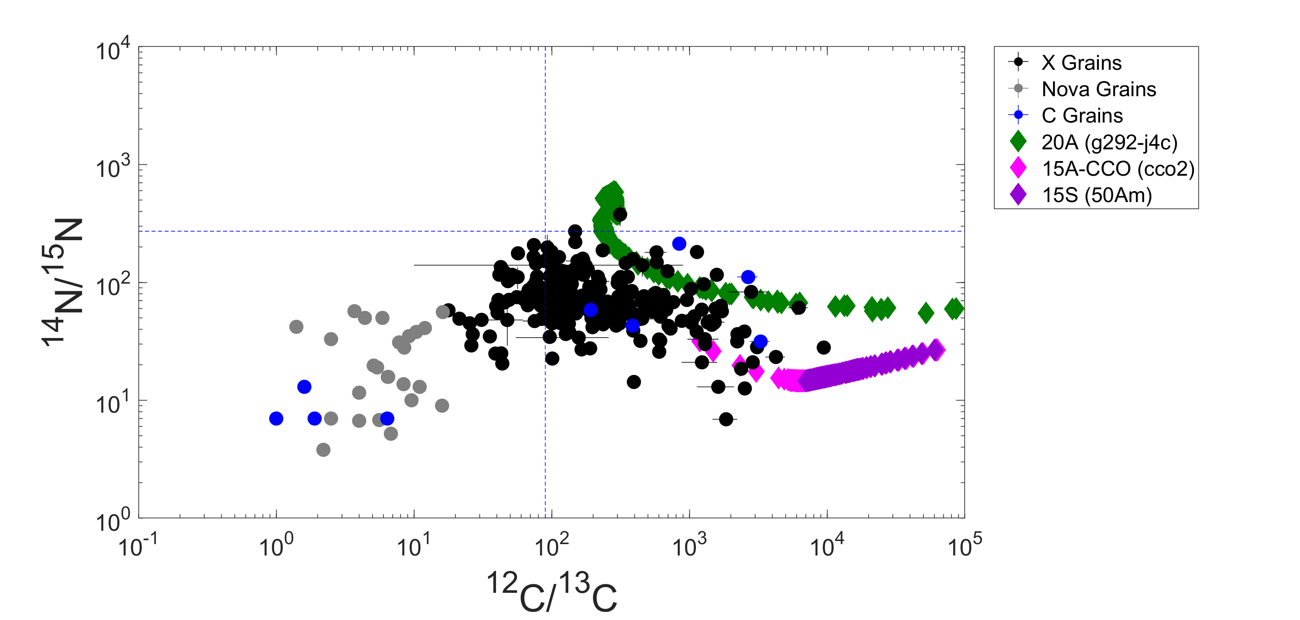
Post-Explosion Models: Carbon & Nitrogen
Solar
Solar

Slide 11
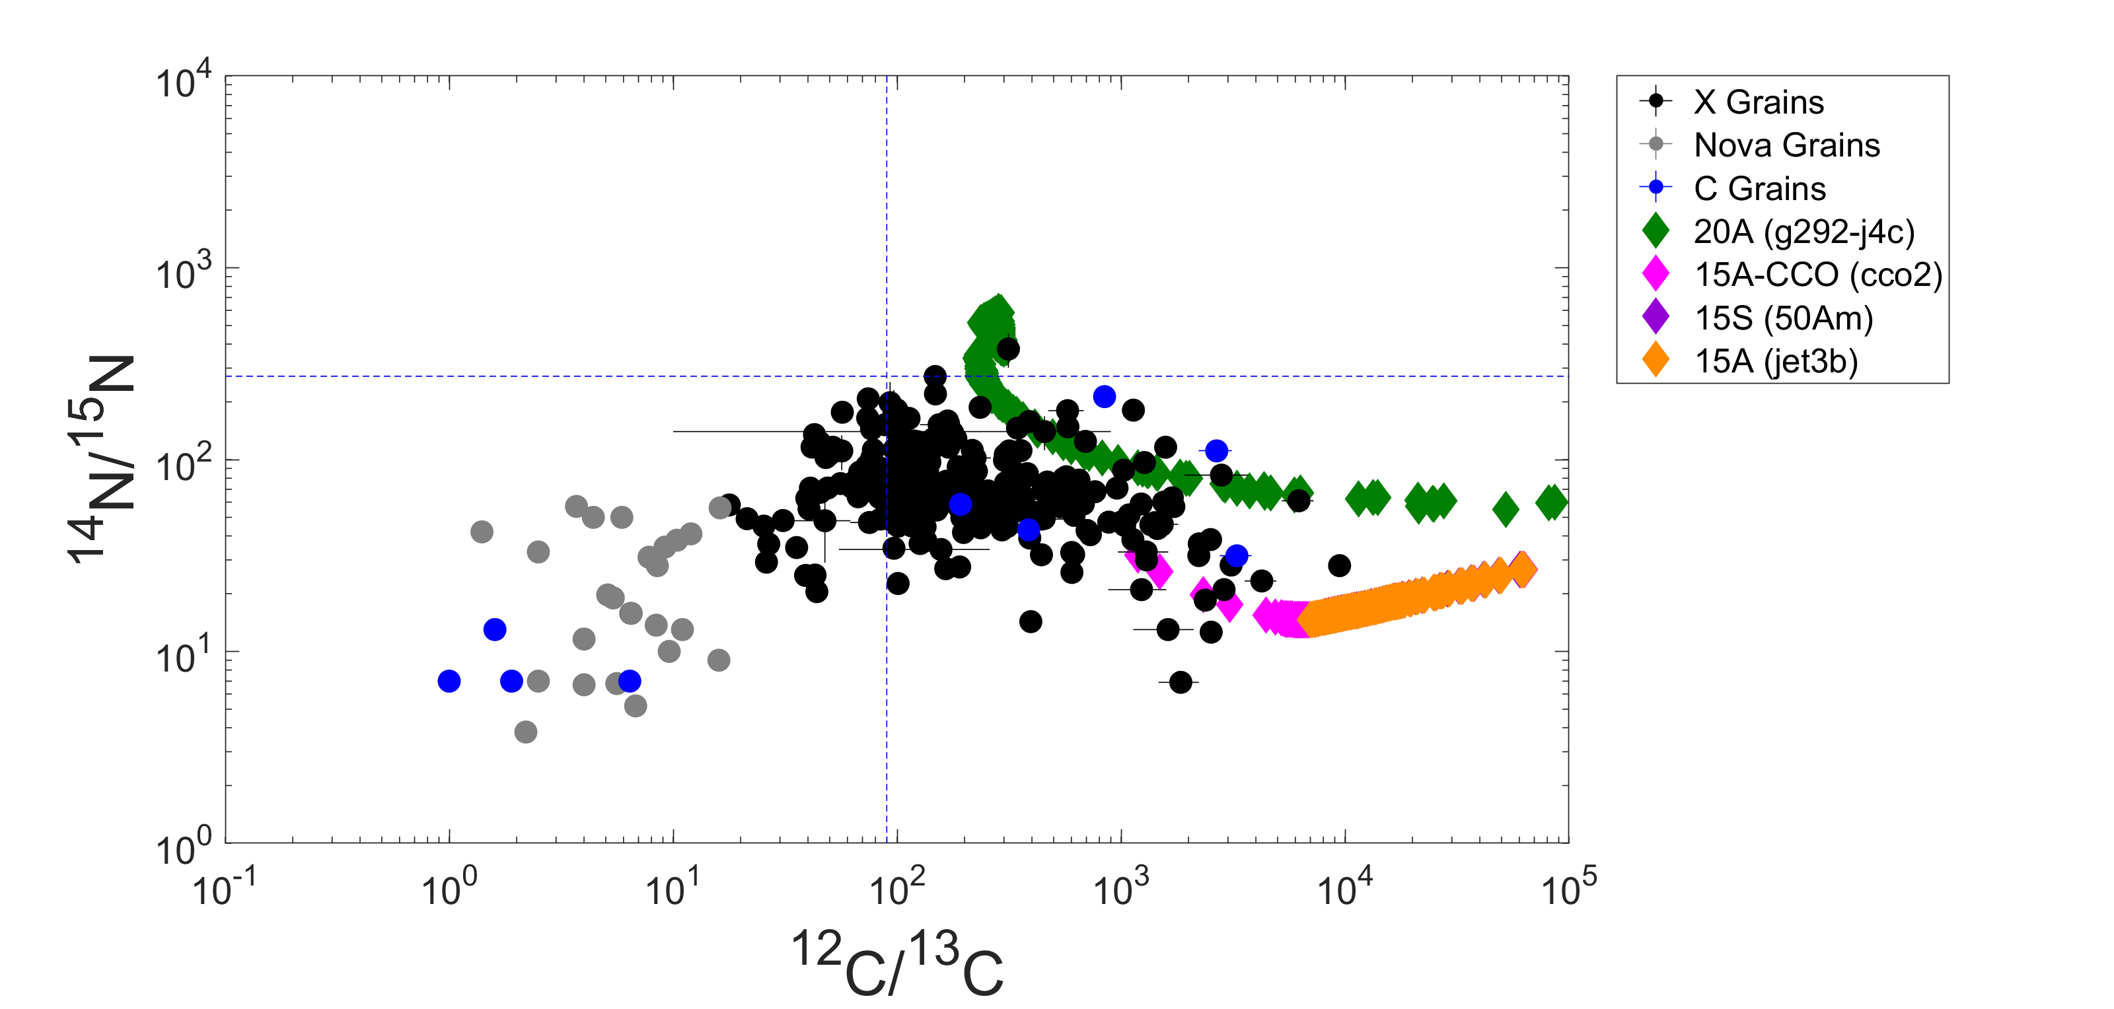
Post-Explosion Models: Carbon & Nitrogen
Solar
Solar

Slide 12
g292-j4c: Iron
Solar
Solar
Notes:
Mention that 54Fe/56Fe doesn’t work for clumps with 57Fe depletions

Slide 13
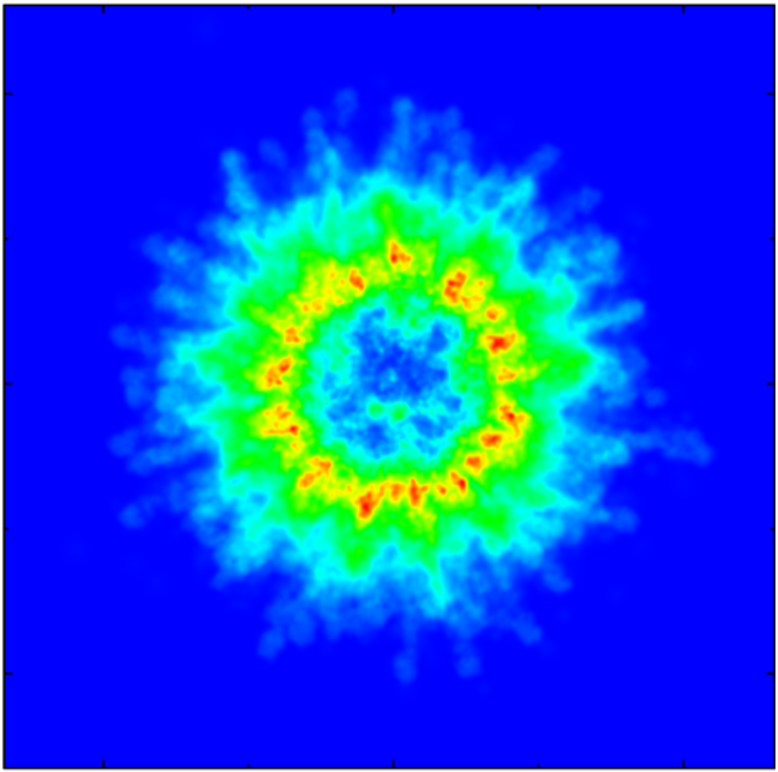
g292-j4c: ⁵⁷Fe
High abundance
Y Direction
X Direction
Low abundance

Slide 14
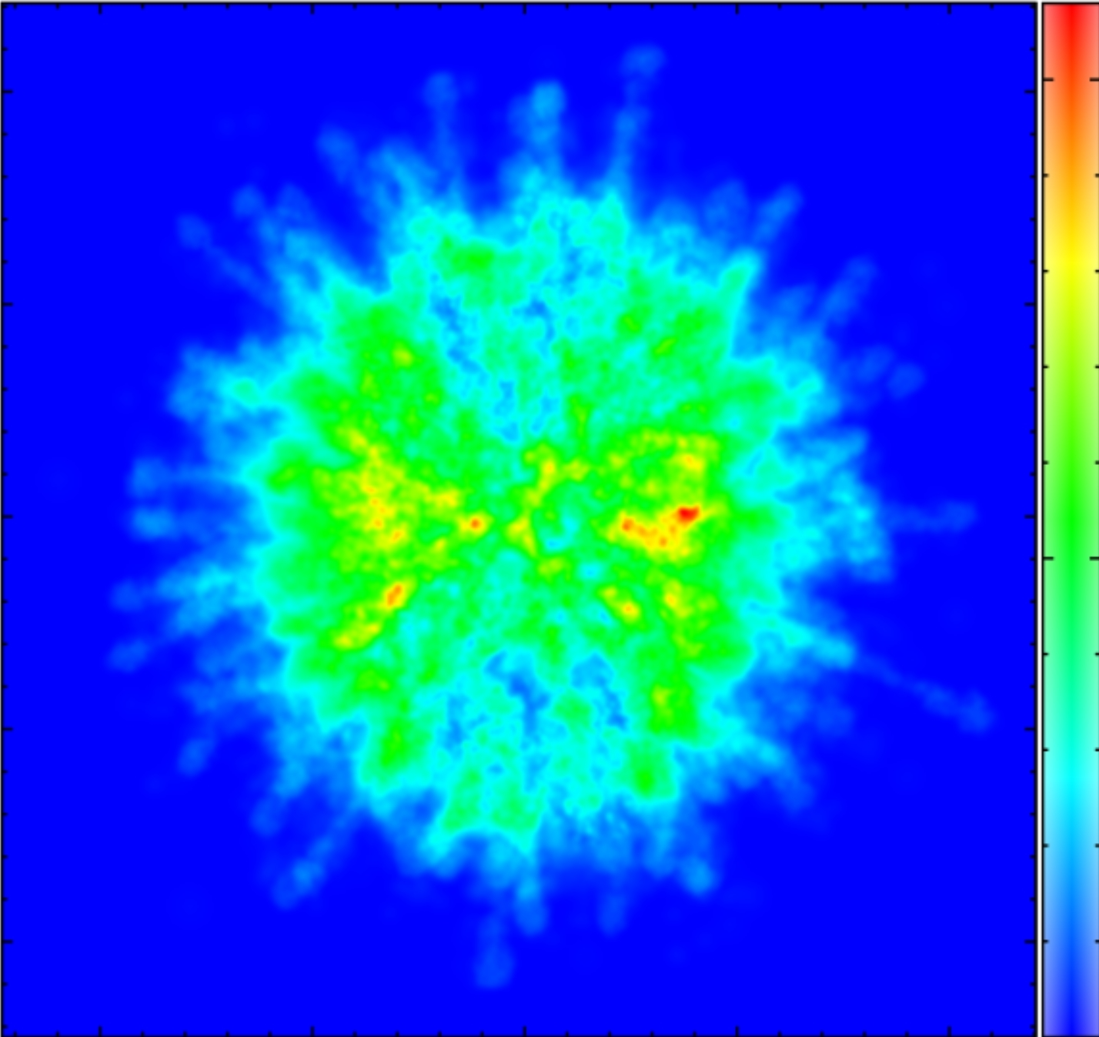
g292-j4c: ⁵⁷Fe
High abundance
Z Direction
X Direction
Low abundance

Slide 15
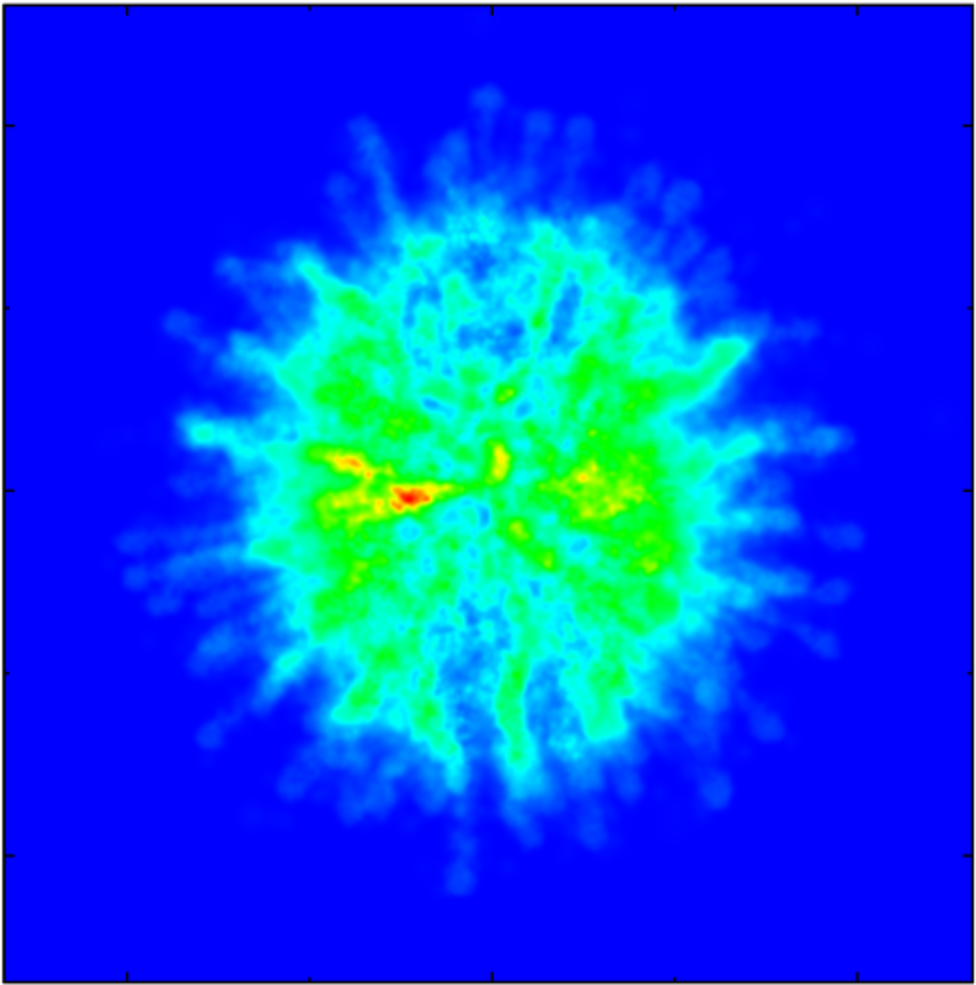
g292-j4c: ⁵⁷Fe
High abundance
Z Direction
Y Direction
Low abundance

Slide 16
Conclusions
15 and 20 M⊙ asymmetric SN models explain SiC X grain compositions
Both ⁵⁷Fe excesses and depletions are observed in clumps from asymmetric models
In the near future, we plan to look at more isotope systems and write a paper!
Notes:
-If asked questions about C/O ratio, mention that this is not an accurate measurement for our purposes because it is an average of all the material in the clump- we would have to luck at the small scale structure of each clump to more accurately determine SiC formation
Comments: I have edited this slide.

